Slide 1
AI Practical Assessment
Lee Xuan Yu U1710806H

Slide 2
Data Link
https://www.dropbox.com/s/lmgm4ry8vago85o/STI.xlsx?dl=0
https://finance.yahoo.com/quote/%5ESTI%3FP%3D%5ESTI/history?period1=567648000&period2=1584662400&interval=1d&filter=history&frequency=1d

Slide 3
Content
Objective
Data Set
Model
Data Visualization
Feature Selection
Prediction Models (Continuous or/and Categorical)
Performance Measurement (Continuous and/or categorical)
Text Analytics (At least 10 Article)
Discussions & Questions

Slide 4
Objective
The objective of this project is to use several indicators, including economic indices, commodity prices, futures prices, interest rates and others to predict the Straits Time Index (STI)’s:
1) Stock Price Value (continuous)
2)  If STI Will Go Up (1) or Down (0) (categorical)
We will be focusing more on the second option as it is easier and more feasible.

Slide 5
The
Dataset

Slide 6
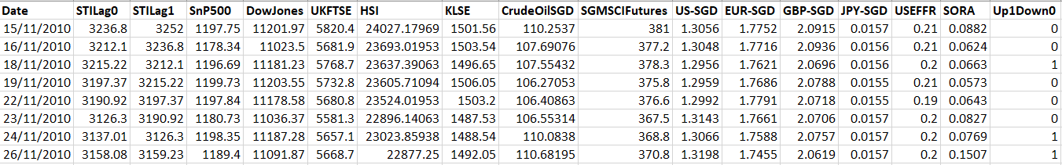
Dataset
All prices are measured in SGD.
Date: Date of the Prices
STILag0: Actual STI Closing Price of the Day
STILag1: STI Closing Price, Lagged by 1 Day
SnP500: Price of the S&P500 Index
DowJones: Price of the Dow Jones Index
UKFTSE: Price of the UK Financial Times Stock Exchange Index
HSI: Price of the Hong Kong Hang Seng Index
KLSE: Price of the Malaysia’s Kuala Lumpur Stock Exchange Index
CrudeOilSGD: Price of Spot Crude Oil
SGMSCIFutures: Price of Singapore’s Emerging Markets Index Futures
US-SGD: Forex Rate of USD:SGD
EUR-SGD: Forex Rate of EUR:SGD
GBP-SGD: Forex Rate of GBP:SGD
JPY-SGD: Forex Rate of JPY:SGD
USEFFR: USA’s Effective Federal Funds Rate
SORA: Singapore’s Overnight Rate Average
Up1Down0: If Price Actually Increased from the Previous Day (1 = yes, 0 = no)

Slide 7
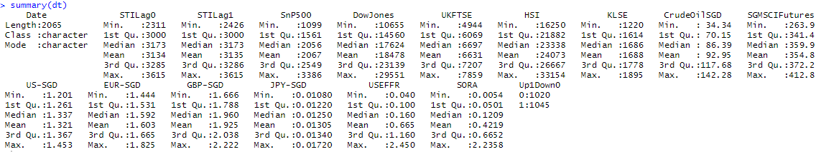
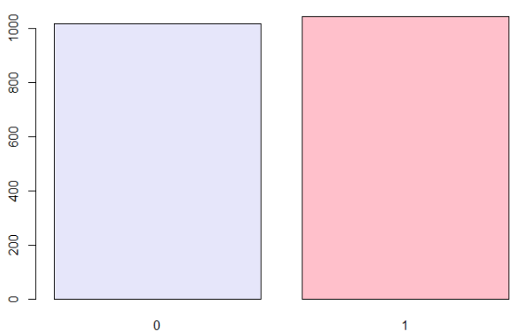
Dataset Exploration
Everything looks good at a summary glance. There are 2065 rows, no missing values, and two columns that can act as the dependent variable (Y-variable): STILag0 if we are predicting continuous variables, and Up1Down0 if we are predicting categorical variables. The Date column will be removed during analyses, while we have 14 independent x-variables to use as predictors.
A simple barplot of the Up1Down0 column also shows that the categories are well-represented, and neither takes an overwhelming majority over the other. Hence, we expect our results to be quite consistent and fair as well.
We have plotted other plots but they are not shown here for conciseness.

Slide 8
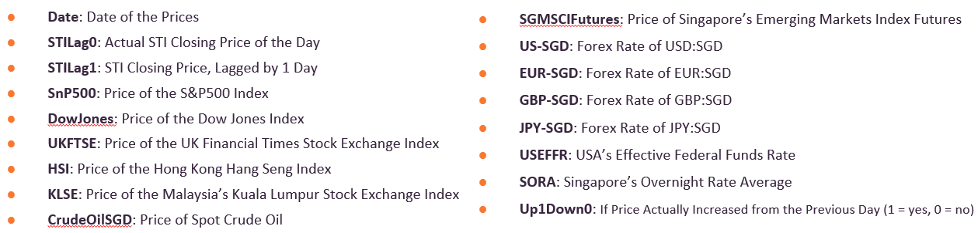
Feature Selection (Quantitative and Qualitative)
The reason why these features were chosen is because:
STILag1: it showed that it was a statistically significant variable in the autoregression model.
SnP500, DowJones, UKFTSE, HIS, KLSE: These are some of the most major stock indices in the world, and these countries (USA, UK, HK, MY) have a strong economic relationship with Singapore in terms of imports and exports. Hence, it is interesting to see whether these indices would be good predictors for the STI.
CrudeOilSGD, SGMSCIFutures: As a financial hub, the commodities market and futures market are part and parcel of everyday Singaporean economy. We wanted to see if these items could significantly predict how the STI moves.
Forex with USD, EUR, GBP, JPY: Singapore also has tremendous transactions with these countries

Slide 9
The Models

Slide 10
Models
Moving Averages
Autoregression
Linear Regression
Logistic Regression
Quantile Regression
MARS
CART
Random Forest
XGBoost
MLP
LSTM
GMM
Naïve Bayesian
SVM

Slide 11
The Models
Regression

Slide 12
1) Moving Averages (Excel)
We conducted 3 different MA analyses: MA10, MA21, and MA50.
We decided on using these due to their short-term and long-term advantages, especially since they are some of the more popular industry standards.
See: https://www.tradeciety.com/how-to-use-moving-averages/
Analysis
From the results of the 3 MA techniques, they all have an accuracy that ranges from 48% to 51%.
This means that generally, using these methods is slightly worse than a random guess.
MA does not effectively account for the volatility in STI, or its cyclical pattern. Some experts may argue that the time period used may be counterproductive (we used 10 years worth of data) as it includes data from too distant a past.
MA | MA10 | MA21 | MA50
SSE | 7242311.34 | 14241617.73 | 26346927.66
RMSE | 143814.46 | 283418.79 | 527360.61
CV | 46.15 | 90.95 | 169.24
# of Correct | 1218.00 | 1284.00 | 1240.00
Accuracy | 48.03 | 50.85 | 49.68
See: https://www.investopedia.com/articles/trading/11/pitfalls-moving-averages.asp

Slide 13
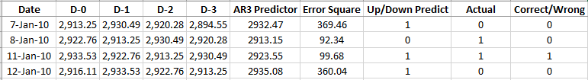
2) Autoregression (Excel)
We conducted autoregression up to a time lag of 3 days.
SSE | 1516932
RMSE | 30128.47
CV | 9.668332
# of Correct | 1321
Accuracy | 52.11045
Analysis
From the result, we can see that the accuracy of 52% is slightly better than that of using Moving Averages. Its performance is only slightly better than a random guess.
The R² of 0.987 is really high, showing that almost all of the observed variation can be explained by the model’s inputs. This is to be expected since the subsequent columns are extremely similar to one another.
Do note that only D-1 (lag of 1 day) is statistically significant, due to its p-value < 0.05. It will be used as a column in our main dataset.
SUMMARY OUTPUT
Regression Statistics
Multiple R | 0.993650008
R Square | 0.987340338
Adjusted R Square | 0.98732538
Standard Error | 24.46059294
Observations | 2543
ANOVA
 | df | SS | MS | F | Significance F
Regression | 3 | 118479011.9 | 39493003.96 | 66006.42449 | 0
Residual | 2539 | 1519136.021 | 598.3206068
Total | 2542 | 119998147.9
 | Coefficients | Standard Error | t Stat | P-value | Lower 95% | Upper 95% | Lower 95.0% | Upper 95.0%
Intercept | 14.0659227 | 7.03183017 | 2.000321731 | 0.045571853 | 0.277215668 | 27.85462972 | 0.277215668 | 27.85462972
X Variable 1 | 1.058483523 | 0.019926012 | 53.12069135 | 0 | 1.019410631 | 1.097556415 | 1.019410631 | 1.097556415
X Variable 2 | -0.035454096 | 0.0289818 | -1.223322765 | 0.221321335 | -0.092284472 | 0.02137628 | -0.092284472 | 0.02137628
X Variable 3 | -0.027615356 | 0.019961284 | -1.383445877 | 0.166649814 | -0.066757412 | 0.011526701 | -0.066757412 | 0.011526701

Slide 14
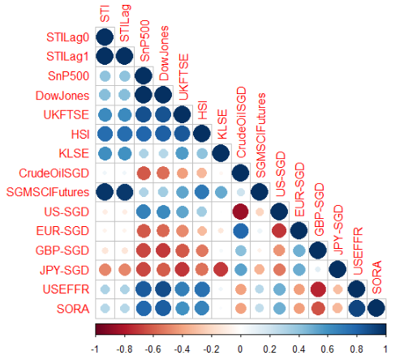
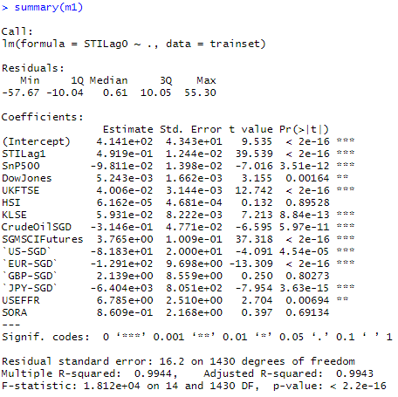
3) Linear Regression: Full Model
Our first linear regression model m1 was created by selecting all features, and it seems that almost all the features were statistically significant (p-value < 0.05, have two or three asterisks) except for HSI, GBP-SGD, and SORA.
This is surprising as in the correlation plot, it showed that CrudeOilSGD, US-SGD, EUR-SGD, and GBP-SGD as those that were not very correlated with STILag0 (y-variable).
However, we must keep in mind that correlation only detects linear relationships. There could be other underlying non-linear relationships that the corrplot is not accounting for. The p-value seems to be a better indicator.
RMSE (Trainset) | 16.12
RMSE (Testset) | 16.43
AIC | 0.9944
R-Squared | 0.9943
Adj R-Squared | 8063.95
p-value | < 2.2e-16

Slide 15
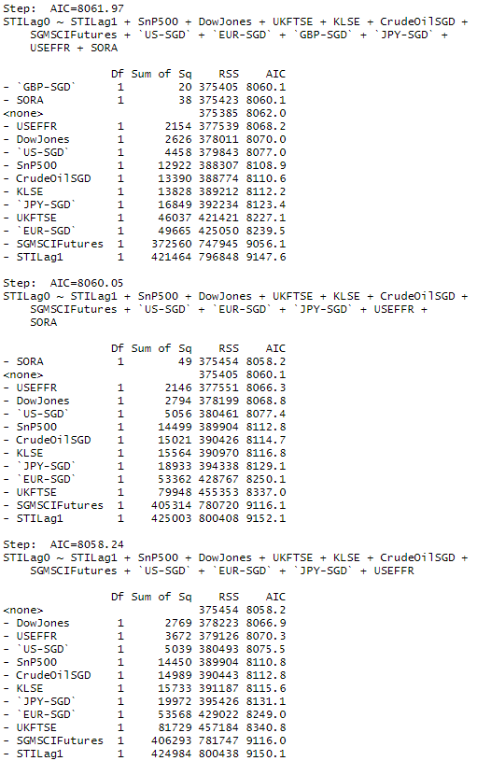
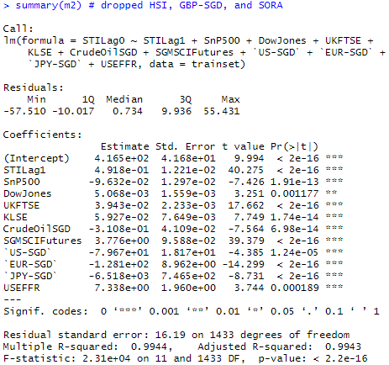
3) Linear Regression: Stepbackward Model
Using the step-backward function, we derived a model that performs better by dropping non-statistically significant x-variables, namely HIS, GBP-SGD, and SORA. These three columns were the same columns pointed out earlier as non-significant.
The AIC of the model is slightly improved (lower is better), and all the remaining x-variables are statistically significant.
RMSE (Trainset) | 16.12
RMSE (Testset) | 16.44
AIC | 0.9944
R-Squared | 0.9943
Adj R-Squared | 8058.24
p-value | < 2.2e-16

Slide 16
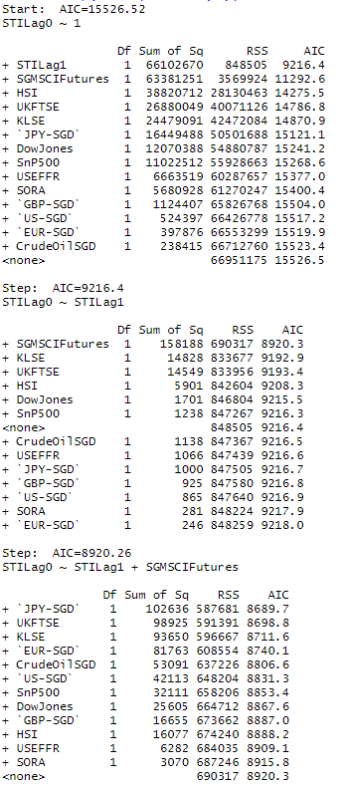
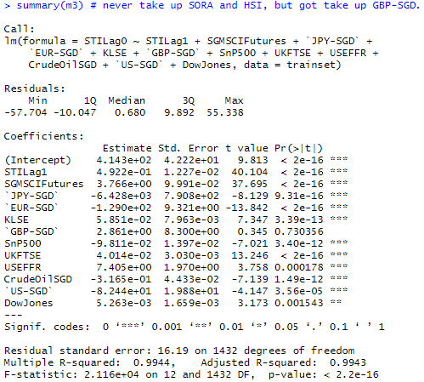
3) Linear Regression: Stepforward Model
We now use the step-forward method, which arrived to a similar model as the step-backward one, except with one difference – we took on the GBP-SGD x-variable.
This might seem strange to us initially, as the variable is statistically non-significant. However, we have to remember that the way we build this model is using AIC as a benchmark, and not p-values.
Furthermore, there are other factors we have not accounted for such as multicollinearity (VIF). This will be done at a later stage (during the model discussion part).
RMSE (Trainset) | 16.12
RMSE (Testset) | 16.44
AIC | 8060.12
R-Squared | 0.9944
Adj R-Squared | 0.9943
p-value | < 2.2e-16
Notes:
https://www.researchgate.net/post/Why_stepAIC_gives_a_model_with_insignificant_variables_in_the_summarymodel2

Slide 17
3) Linear Regression: Quick Summary
m1 (full) |  | m2 (backward) |  | m3 (forward)
RMSE (Trainset) | 16.12 | RMSE (Trainset) | 16.12 | RMSE (Trainset) | 16.12
RMSE (Testset) | 16.43 | RMSE (Testset) | 16.44 | RMSE (Testset) | 16.43
AIC | 8063.95 | AIC | 8058.24 | AIC | 8063.95
R-Squared | 0.9944 | R-Squared | 0.9944 | R-Squared | 0.9944
Adj R-Squared | 0.9943 | Adj R-Squared | 0.9943 | Adj R-Squared | 0.9943
p-value | < 2.2e-16 | p-value | < 2.2e-16 | p-value | < 2.2e-16
The results for all three models are roughly the same, except that m2 (step-backwards) beats m1 and m3 by having a lower AIC. This could be due to it dropping the most number of x-variables to have a better fit. In contrast, the step-forward model m3 used brute force to try every variable, and even added a non-significant variable.
However, all 3 models are not good enough as there is a lot of multicollinearity going on in the models as seen by the high VIF scores for the individual x-variables. A VIF score of more than 10 is usually regarded as denoting that the x-variable can be explained by other x-variables, i.e. it is unnecessary to be included in the model.
Hence, the linear regression models can be better improved by sequentially removing x-variables with high VIFs and testing the models again, until the remnant x-variables have low VIF scores, reducing multicollinearity.

Slide 18
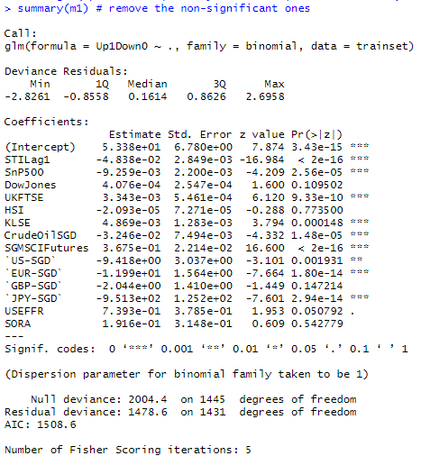
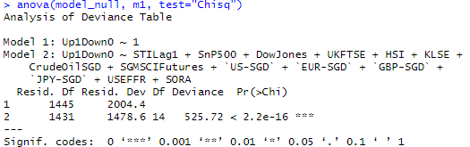


4) Logistic Regression – Full Model
Compared to linear regression, there are fewer but still many x-variables that are statistically significant (p-value < 0.05, have two or three asterisks).
Taking the cut-off p-value to be 0.05, then the x-variables that are not statistically significant are DowJones, HSI, GBP-SGD, USEFFR, and SORA. Note how HSI, GBP-SGD, and SORA appear here again as non-statistically significant predictors.
From this model, we can evaluate that:
These are really good numbers as the accuracy rate for both the trainset and testset are high at > 75% (way better than random chance) and that the numbers are similar showing that the model works and did not overfit on the trainset.
 |  | Trainset | Testset
Accuracy | (TP+TN) / (TP+TN+FP+FN) | 0.7683 | 0.7512
Precision | TP / (TP+FP) | 0.7753 | 0.7446
Recall | TP / (TP+FN) | 0.7637 | 0.7732
Specificity | TN / (TN+FN) | 0.7614 | 0.7585
False Positive Rate | FP / (TN + FP) | 0.2269 | 0.2712
The AIC of the model is 1508.6.
The overall model has a p-value of < 2.2e-16. It is statistically significant.

Slide 19
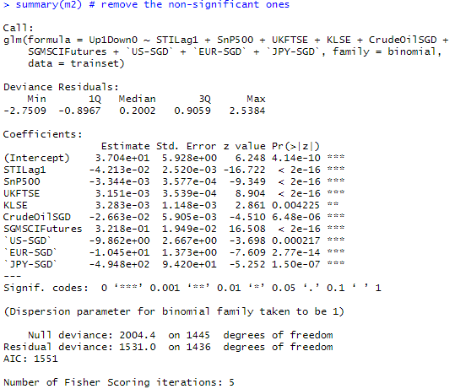
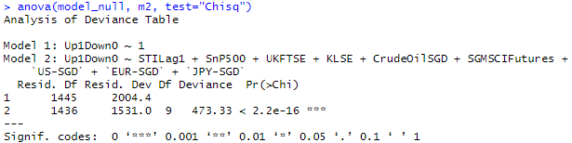


4) Logistic Regression – Selected Features Only
This model is the same as the previous, except using only the x-variables that were statistically significant. All turned out to be statistically significant once more.
From this model, we can evaluate that:
These are really good numbers once again as the accuracy rate for both the trainset and testset are high at > 72% (way better than random chance) and that the numbers are similar showing that the model works and did not overfit on the trainset.
m2 is a slight deprovement from m1 though.
The AIC of the model is 1551, which is higher than m1’s 1508.6. This means m2 has a weaker fit to the dataset.
The overall model has a p-value of < 2.2e-16. It is statistically significant.
 |  | Trainset | Testset
Accuracy | (TP+TN) / (TP+TN+FP+FN) | 0.7365 | 0.7205
Precision | TP / (TP+FP) | 0.7421 | 0.7147
Recall | TP / (TP+FN) | 0.7350 | 0.7444
Specificity | TN / (TN+FN) | 0.7309 | 0.7270
False Positive Rate | FP / (TN + FP) | 0.2619 | 0.3039

Slide 20
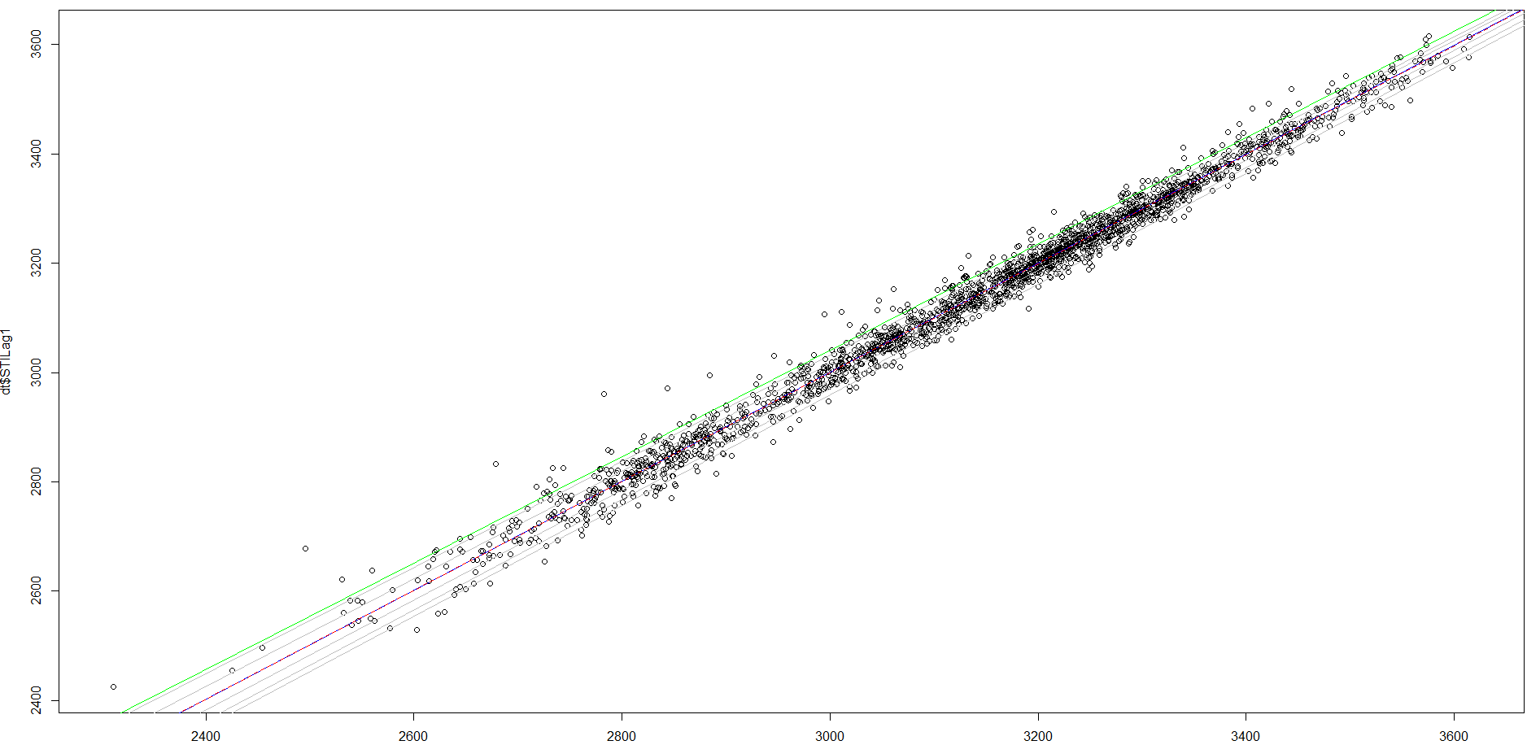
5) Quantile Regression
Not much was done with the quantile regression technique.
However, here is a nice graph showing all the lines at different tau values.

Slide 21
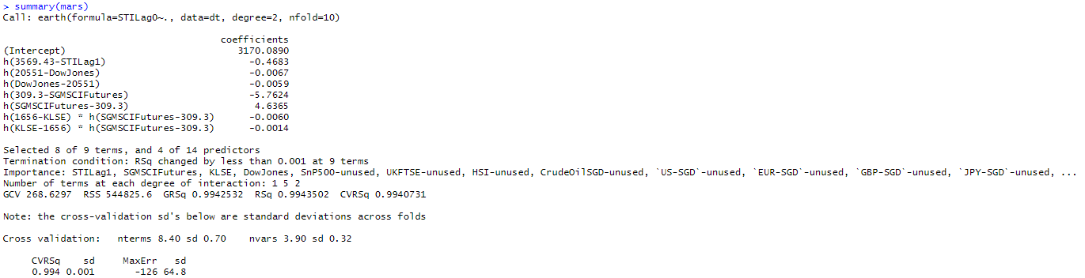

6) MARS
RMSE (Trainset) | 16.24309
RMSE (Testset) | -
AIC | -
R-Squared | 0.9944
Adj R-Squared | -
p-value | -
The MARS model when compared to the linear model actually suffers from a slight deprovement of 0.26%.
This could be due to heteroscedasticity to which MARS is negatively affected by, but did not as adversely affect the linear regression.
This could also be due to multicollinearity, to which MARS was more adversely affected than by linear regression.
In any case, the difference between them is very small, and both models are more or less the same for this dataset.

Slide 22
The Models
Decision Trees

Slide 23
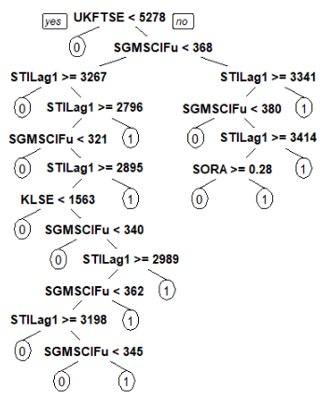
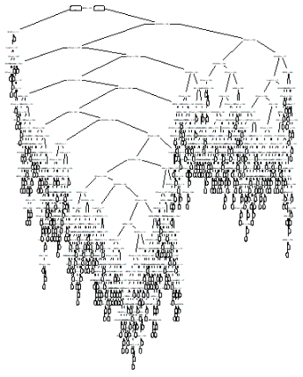
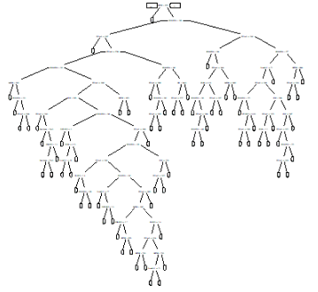
7) CART on Categorical Y
Default Tree
Maximal Tree
Pruned Tree
The CART Decision Tree is one of the most basic decision trees that is good to categorising data points to different groups. It does this by minimising the Gini index coefficient at each split.
The default tree is the easiest to look at but it does not show the complete picture. The maximal tree is also too huge to be used effectively – it is very huge so as to minimise the misclassification rate.
Hence, we usually use the pruned tree where it shows enough and has low cross-validation error while limiting overfitting. This is why we must prune because we get a complex enough tree and is not too big – it is a just-nice sized.

Slide 24



7) CART on Categorical Y
Default Tree
Maximal Tree
Pruned Tree
 |  | Default | Maximal | Pruned
Accuracy | (TP+TN) / (TP+TN+FP+FN) | 0.6634 | 1.0000 | 0.8131
Precision | TP / (TP+FP) | 0.6420 | 1.0000 | 0.8071
Recall | TP / (TP+FN) | 0.7569 | 1.0000 | 0.8287
Specificity | TN / (TN+FN) | 0.6951 | 1.0000 | 0.8196
False Positive Rate | FP / (TN + FP) | 0.4324 | 0.0000 | 0.2029
Assessing the results, it seems that the default one is the worst performing at 66% accuracy, while the maximal one is the best performing at 100% accuracy. This is really amazing! However, the tree is really too huge and has overfitted to the entire dataset. It may not perform as well in predicting future data. Hence, this is why we use the pruned tree.
Since CART uses the K-folds cross validation method, it trains on the entire dataset and thereafter tests on it as well. The results for the pruned tree look good with an 81% accuracy rate and an 81% precision. This shows that CART is a good categorising tool for this dataset.
Seeing the variable importance, it shows that some of the variables that are tightly linked to predicting if the STI would rise or not are STILag1, SGMSCIFutures, UKFTSE, and SnP500 just to name the top four. In a sense, this is like using CART as a features selection method.

Slide 25
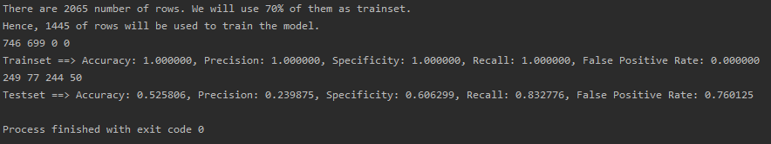
8) Random Forest
Trainset |  |  |  | Testset
 | 0 | 1 |  |  | 0 | 1
0 | 699 | 0 |  | 0 | 77 | 244
1 | 0 | 746 |  | 1 | 50 | 249
 |  | Trainset | Testset
Accuracy | (TP+TN) / (TP+TN+FP+FN) | 1.0000 | 0.5258
Precision | TP / (TP+FP) | 1.0000 | 0.5051
Recall | TP / (TP+FN) | 1.0000 | 0.8328
Specificity | TN / (TN+FN) | 1.0000 | 0.6063
False Positive Rate | FP / (TN + FP) | 0.0000 | 0.7601
RandomForests tend to be better than normal decision trees because they make use of bootstrapping and bagging. This allows the model to randomly sample a subset of observations and create multiple decision trees, and then it aggregates their results. There is a lot of aggregation of the weaker learners.
In fact for the trainset, it performs exceptionally well at 100% accuracy. This is due to the above reasons and for running enough trees. However, this could also mean that the model has overfitted on the trainset and may not be as good with new data.
However, its testset is not as accurate as CART’s, being at 53%. This is a far cry from CART’s 81%. This could be because we did a train-test split for RandomForest while we did not for CART. Furthermore, bagging is done parallel instead of sequentially, so you keep a lot of the mistakes. If it were done sequentially, you can focus on the mistakes and improve your tree to make it better.
Notes:
https://stats.stackexchange.com/questions/241062/why-decision-tree-is-outperforming-random-forest-in-this-simple-case

Slide 26
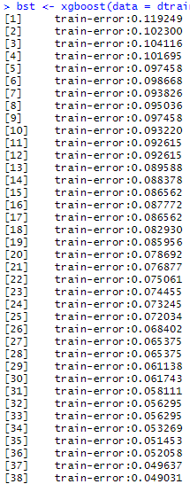
9) XGBoost
Trainset |  |  |  | Testset
 | 0 | 1 |  |  | 0 | 1
0 | 809 | 0 |  | 0 | 143 | 68
1 | 0 | 843 |  | 1 | 55 | 147
 |  | Trainset | Testset
Accuracy | (TP+TN) / (TP+TN+FP+FN) | 1.0000 | 0.7022
Precision | TP / (TP+FP) | 1.0000 | 0.6837
Recall | TP / (TP+FN) | 1.0000 | 0.7277
Specificity | TN / (TN+FN) | 1.0000 | 0.7222
False Positive Rate | FP / (TN + FP) | 0.0000 | 0.3223
XGBoost (Extreme Gradient Boosting) is one of the most powerful decision tree ensembles currently in the industry. It can handle large datasets, is fast, and boasts good model performance.
Its key element is its ability to handle the weaker learners sequentially, then utilises gradient boosting to boost the weak learners by minimising the gradient of the loss function. In essence, this is like improving on the weak parts of the overall model, so it becomes stronger overall.
As seen, the trainset accuracy is at 100% while its testset is at 70%. This is higher than RandomForest’s results, proving that it is better.
One might then ask – why is its testset accuracy lower than CART’s pruned one then (81%)? In the industry, XGBoost is still considered one of the best machine learning decision trees on the market. There is a possibility that even after pruning, CART’s model could be still overfitting on the data such that if it were to be tested on new data, it would perform worse. Furthermore, it is a single decision tree that only happened to perform well on this dataset – if given another type, it might perform worse. Another reason is that the XGBoost model has not been tuned to its best performing ability by exhausting all possible hyperparameter tweaks due to the limitations of time and resources.
Another reason is that CART, despite using the cross-validation technique, has actually seen the testdata for some of its models. We did not train over the whole dataset in XGBoost and had rather split into train and test sets, where the test sets were not trained on at all. This could be why CART did better than XGBoost. Notwithstanding, an accuracy of 70% despite this shows how powerful XGBoost is.
Notes:
https://stats.stackexchange.com/questions/241062/why-decision-tree-is-outperforming-random-forest-in-this-simple-case

Slide 27
The Models
Neural Networks

Slide 28
10) MLP (Multi Layer Perceptron)
Batch | 1
Epoch | 25
Timestep | -
# Hidden Layers | 4
# Neurons Per Layer | 10, 8, 6, 1
 |  | Trainset | Testset
Accuracy | (TP+TN) / (TP+TN+FP+FN) | 0.5211 | 0.4823
Precision | TP / (TP+FP) | 0.5207 | 0.4823
Recall | TP / (TP+FN) | 0.9115 | 1.0000
Specificity | TN / (TN+FN) | 0.5252 | 0.0000
False Positive Rate | FP / (TN + FP) | 0.8956 | 1.0000
Trainset |  |  |  | Testset
 | 0 | 1 |  |  | 0 | 1
0 | 73 | 626 |  | 0 | 0 | 321
1 | 66 | 680 |  | 1 | 0 | 299
Our first neural network is the MLP, which is a supposedly good model for mapping inputs to outputs in a classification problem.
However, one of its pitfalls is that it is a non-sequential model that usually handles non-sequential data. While it can handle sequential data, it will not perform well.
This is as seen by its weak trainset and testset accuracy at 52% and 48% respectively. This shows that it is not a very reliable model to use, and is only marginally better (or some say worse) than a random guess.
Looking at the confusion matrices for both trainset and testset, it was heavily favouring the target of “1”. Perhaps the model was not tweaked as efficiently as it could be, or the model just does not perform well with sequential data.

Slide 29
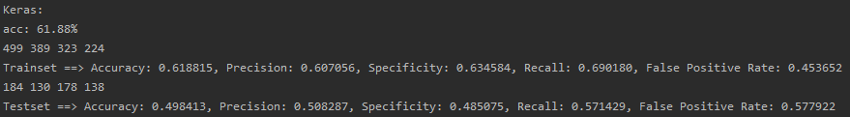
11) LSTM Long Short-Term Memory
Batch | 1
Epoch | 100
Timestep | 35
# Hidden Layers | 4
# Neurons Per Layer | 36, 24, 16, 10
LSTM is one of the top sequential neural network models because of its key attributes: it is able to remember the earlier parts of the sequential data due to its unique forget gate. It then has this short-term and long-term memory components to help it better analyse data and not forget early data unlike the ordinary neural networks.
Unfortunately, the results from our LSTM are not that great. The trainset accuracy is 62% (this is quite good actually) but the testset comes out at only 50%. This means that our model does not have a good predicting accuracy, unlike some of our earlier models.
Some reasons for this low testset accuracy could be due to the hyperparameters may not be the most optimal ones. Another reason could be that the random weight initialisations might have been onerous for the model training as LSTMs are very sensitive to the random weight initialisations. Or another reason is that the Dropout layers that were meant for regularisation were too high a number and caused many things to be
Nevertheless, our LSTM shows improvement over the MLP model.
Trainset |  |  |  | Testset
 | 0 | 1 |  |  | 0 | 1
0 | 389 | 323 |  | 0 | 130 | 178
1 | 224 | 499 |  | 1 | 138 | 184
 |  | Trainset | Testset
Accuracy | (TP+TN) / (TP+TN+FP+FN) | 0.6188 | 0.4984
Precision | TP / (TP+FP) | 0.6071 | 0.5083
Recall | TP / (TP+FN) | 0.6902 | 0.5714
Specificity | TN / (TN+FN) | 0.6346 | 0.4851
False Positive Rate | FP / (TN + FP) | 0.4537 | 0.5779

Slide 30
The Models
Others

Slide 31
12) GMM Gaussian Mixture Model
Trainset |  |  |  | Testset
 | 0 | 1 |  |  | 0 | 1
0 | 315 | 384 |  | 0 | 0 | 321
1 | 347 | 399 |  | 1 | 0 | 299
 |  | Trainset | Testset
Accuracy | (TP+TN) / (TP+TN+FP+FN) | 0.4941 | 0.4823
Precision | TP / (TP+FP) | 0.5096 | 0.4823
Recall | TP / (TP+FN) | 0.5349 | 1.0000
Specificity | TN / (TN+FN) | 0.4758 | 0.0000
False Positive Rate | FP / (TN + FP) | 0.5494 | 1.0000
The Gaussian Mixture Model is one of the better clustering algorithm models. As such, its strength lies in accurately clustering data points into different sets.
This model did not score very well with our dataset. Its trainset and testset accuracy stand at 49% and 48% respectively. It is just predicting a “1” throughout.
Perhaps the reason for the poor scores is because we are using the wrong model for the wrong dataset. The GMM will probably do better in other sorts of clustering problems, but probably not for sequential time series data.

Slide 32
13) Naïve Bayesian
The Naïve Bayesian model is a probabilistic classifier model that helps to categorise data into different targets.
One key feature / disadvantage is that it relies extremely strongly on the feature independence assumption. It means that it assumes there is zero multicollinearity between each feature / x-variable.
As we have seen, this is obviously not the case as we called VIF in the linear regression model. Using common sense and general knowledge, we can tell that many of the economic indicators all rely somewhat on one another.
This is why this model has a poor trainset and testset accuracy of 54% and 49% respectively. In fact, we can see from the confusion matrix that it is mainly just predicting “1” throughout.
It is a slight improvement from the Gaussian Mixture Model though.
Trainset |  |  |  | Testset
 | 0 | 1 |  |  | 0 | 1
0 | 325 | 374 |  | 0 | 4 | 317
1 | 294 | 452 |  | 1 | 1 | 298
 |  | Trainset | Testset
Accuracy | (TP+TN) / (TP+TN+FP+FN) | 0.5377 | 0.4871
Precision | TP / (TP+FP) | 0.5472 | 0.4846
Recall | TP / (TP+FN) | 0.6059 | 0.9967
Specificity | TN / (TN+FN) | 0.5250 | 0.8000
False Positive Rate | FP / (TN + FP) | 0.5351 | 0.9875

Slide 33
14) SVM Support Vector Machine
The support vector machine is another classification algorithm model that attempts to classify trained data into different groups. It uses a separating hyperplane that separates data points into different groups.
The SVM model did not work very well on our dataset. While on the trainset it has a spectacular accuracy of 72%, it did poorly on the testset of 49%.
This could be because the model is very sensitive to noise – it attempts to fit itself onto so many data points that its separating hyperplane is so distorted by the noise.
That could be why as seen in the testset confusion matrix, most of the predictions are all just “1”.
Another reason could be that the hyperparameters were not fine-tuned to be as optimal as they could be as well. However, the “linear” kernel was the best performing option for our dataset.
Trainset |  |  |  | Testset
 | 0 | 1 |  |  | 0 | 1
0 | 485 | 214 |  | 0 | 6 | 315
1 | 194 | 552 |  | 1 | 0 | 299
 |  | Trainset | Testset
Accuracy | (TP+TN) / (TP+TN+FP+FN) | 0.7176 | 0.4919
Precision | TP / (TP+FP) | 0.7206 | 0.4870
Recall | TP / (TP+FN) | 0.7399 | 1.0000
Specificity | TN / (TN+FN) | 0.7143 | 1.0000
False Positive Rate | FP / (TN + FP) | 0.3062 | 0.9813

Slide 34
The Models
Performance Measurement

Slide 35
Performance Measurement (Continuous)
 | MA10 | MA21 | MA50 | Autoregression | Linear Regression (Full) | Linear Regression (Backward) | Linear Regression (Forward) | MARS
RMSE (Trainset) | 143814.46 | 283418.79 | 527360.61 | 30128.47 | 16.12 | 16.12 | 16.12 | 16.24
RMSE (Testset) | - | - | - | - | 16.43 | 16.44 | 16.44 | -
R-Squared | - | - | - | 0.9873 | 0.9944 | 0.9944 | 0.9944 | 0.9944
Adj R-Squared | - | - | - | 0.9873 | 0.9943 | 0.9943 | 0.9943 | -
AIC | - | - | - | - | 8063.9500 | 8058.2400 | 8060.12 | -
p-value | - | - | - | - | < 2.2e-16 | < 2.2e-16 | < 2.2e-16 | -
Accuracy | 48.03 | 50.85 | 49.68 | 52.11 | - | - | - | -
From the continuous models (especially the models to the right of the box), it seems that they are all pretty similar sharing the same R-Squared value of 0.9944. They too share the same Adjusted R-Squared value of 0.9943 as well.
Even the autoregression model performed well enough with an R² of 0.9873.
If we had to pick just one model, it would probably be the Linear Regression (Backward) model, because out of all the models, it has the lowest AIC value.
The model can be further improved though by checking for multicollinearity and removing the offending columns.

Slide 36
Performance Measurement (Categorical)
 |  | Logistic (Full) Trainset | Logistic (Full) Testset | Logistic (Reduced) Trainset | Logistic (Reduced) Testset | CART Default | CART Maximal | CART Pruned | RF Trainset | RF Testset | XGBoost Trainset | XGBoost Testset | MLP Trainset | MLP Testset | LSTM Trainset | LSTM Testset | GMM Trainset | GMM Testset | NB Trainset | NB Testset | SVM Trainset | SVM Testset
Accuracy | (TP+TN) / (TP+TN+FP+FN) | 0.7683 | 0.7512 | 0.7365 | 0.7205 | 0.6634 | 1.0000 | 0.8131 | 1.0000 | 0.5258 | 1.0000 | 0.7022 | 0.5211 | 0.4823 | 0.6188 | 0.4984 | 0.4941 | 0.4823 | 0.5377 | 0.4871 | 0.7176 | 0.4919
Precision | TP / (TP+FP) | 0.7753 | 0.7446 | 0.7421 | 0.7147 | 0.6420 | 1.0000 | 0.8071 | 1.0000 | 0.5051 | 1.0000 | 0.6837 | 0.5207 | 0.4823 | 0.6071 | 0.5083 | 0.5096 | 0.4823 | 0.5472 | 0.4846 | 0.7206 | 0.4870
Recall | TP / (TP+FN) | 0.7637 | 0.7732 | 0.7350 | 0.7444 | 0.7569 | 1.0000 | 0.8287 | 1.0000 | 0.8328 | 1.0000 | 0.7277 | 0.9115 | 1.0000 | 0.6902 | 0.5714 | 0.5349 | 1.0000 | 0.6059 | 0.9967 | 0.7399 | 1.0000
Specificity | TN / (TN+FN) | 0.7614 | 0.7585 | 0.7309 | 0.7270 | 0.6951 | 1.0000 | 0.8196 | 1.0000 | 0.6063 | 1.0000 | 0.7222 | 0.5252 | 0.0000 | 0.6346 | 0.4851 | 0.4758 | 0.0000 | 0.5250 | 0.8000 | 0.7143 | 1.0000
False Positive Rate | FP / (TN + FP) | 0.2269 | 0.2712 | 0.2619 | 0.3039 | 0.4324 | 0.0000 | 0.2029 | 0.0000 | 0.7601 | 0.0000 | 0.3223 | 0.8956 | 1.0000 | 0.4537 | 0.5779 | 0.5494 | 1.0000 | 0.5351 | 0.9875 | 0.3062 | 0.9813
Testsets Only |  | Logistic (Full) Testset | Logistic (Reduced) Testset | CART Pruned | RF Testset | XGBoost Testset | MLP Testset | LSTM Testset | GMM Testset | NB Testset | SVM Testset
Accuracy | (TP+TN) / (TP+TN+FP+FN) | 0.7512 | 0.7205 | 0.8131 | 0.5258 | 0.7022 | 0.4823 | 0.4984 | 0.4823 | 0.4871 | 0.4919
Precision | TP / (TP+FP) | 0.7446 | 0.7147 | 0.8071 | 0.5051 | 0.6837 | 0.4823 | 0.5083 | 0.4823 | 0.4846 | 0.4870
Recall | TP / (TP+FN) | 0.7732 | 0.7444 | 0.8287 | 0.8328 | 0.7277 | 1.0000 | 0.5714 | 1.0000 | 0.9967 | 1.0000
Specificity | TN / (TN+FN) | 0.7585 | 0.7270 | 0.8196 | 0.6063 | 0.7222 | 0.0000 | 0.4851 | 0.0000 | 0.8000 | 1.0000
False Positive Rate | FP / (TN + FP) | 0.2712 | 0.3039 | 0.2029 | 0.7601 | 0.3223 | 1.0000 | 0.5779 | 1.0000 | 0.9875 | 0.9813
From the categorical models, we have so much information that we shall zoom in on the testsets’ results only so as to reduce the scope and keep focus on choosing a model that can predict the direction of STI.
Three of the best performing models include the Logistic (Full) Regression, CART (Pruned), and XGBoost with accuracies of 75%, 81% and 70% respectively.
In fact, the model with the most consistent performance is the Logistic (Full) Regression one as its trainset and testset results are the closest amongst all the other models. If I were to choose a model for this dataset, this model could be it.
That said, perhaps the other more complex models could have performed better but did not due to not selecting the best hyperparameters. With more time and resources, we probably can raise the results of those other models.

Slide 37
Performance Measurement (Categorical)
 |  | Logistic (Full) Trainset | Logistic (Full) Testset | Logistic (Reduced) Trainset | Logistic (Reduced) Testset | CART Default | CART Maximal | CART Pruned | RF Trainset | RF Testset | XGBoost Trainset | XGBoost Testset | MLP Trainset | MLP Testset | LSTM Trainset | LSTM Testset | GMM Trainset | GMM Testset | NB Trainset | NB Testset | SVM Trainset | SVM Testset
Accuracy | (TP+TN) / (TP+TN+FP+FN) | 0.7683 | 0.7512 | 0.7365 | 0.7205 | 0.6634 | 1.0000 | 0.8131 | 1.0000 | 0.5258 | 1.0000 | 0.7022 | 0.5211 | 0.4823 | 0.6188 | 0.4984 | 0.4941 | 0.4823 | 0.5377 | 0.4871 | 0.7176 | 0.4919
Precision | TP / (TP+FP) | 0.7753 | 0.7446 | 0.7421 | 0.7147 | 0.6420 | 1.0000 | 0.8071 | 1.0000 | 0.5051 | 1.0000 | 0.6837 | 0.5207 | 0.4823 | 0.6071 | 0.5083 | 0.5096 | 0.4823 | 0.5472 | 0.4846 | 0.7206 | 0.4870
Recall | TP / (TP+FN) | 0.7637 | 0.7732 | 0.7350 | 0.7444 | 0.7569 | 1.0000 | 0.8287 | 1.0000 | 0.8328 | 1.0000 | 0.7277 | 0.9115 | 1.0000 | 0.6902 | 0.5714 | 0.5349 | 1.0000 | 0.6059 | 0.9967 | 0.7399 | 1.0000
Specificity | TN / (TN+FN) | 0.7614 | 0.7585 | 0.7309 | 0.7270 | 0.6951 | 1.0000 | 0.8196 | 1.0000 | 0.6063 | 1.0000 | 0.7222 | 0.5252 | 0.0000 | 0.6346 | 0.4851 | 0.4758 | 0.0000 | 0.5250 | 0.8000 | 0.7143 | 1.0000
False Positive Rate | FP / (TN + FP) | 0.2269 | 0.2712 | 0.2619 | 0.3039 | 0.4324 | 0.0000 | 0.2029 | 0.0000 | 0.7601 | 0.0000 | 0.3223 | 0.8956 | 1.0000 | 0.4537 | 0.5779 | 0.5494 | 1.0000 | 0.5351 | 0.9875 | 0.3062 | 0.9813
Testsets Only |  | Logistic (Full) Testset | Logistic (Reduced) Testset | CART Pruned | RF Testset | XGBoost Testset | MLP Testset | LSTM Testset | GMM Testset | NB Testset | SVM Testset
Accuracy | (TP+TN) / (TP+TN+FP+FN) | 0.7512 | 0.7205 | 0.8131 | 0.5258 | 0.7022 | 0.4823 | 0.4984 | 0.4823 | 0.4871 | 0.4919
Precision | TP / (TP+FP) | 0.7446 | 0.7147 | 0.8071 | 0.5051 | 0.6837 | 0.4823 | 0.5083 | 0.4823 | 0.4846 | 0.4870
Recall | TP / (TP+FN) | 0.7732 | 0.7444 | 0.8287 | 0.8328 | 0.7277 | 1.0000 | 0.5714 | 1.0000 | 0.9967 | 1.0000
Specificity | TN / (TN+FN) | 0.7585 | 0.7270 | 0.8196 | 0.6063 | 0.7222 | 0.0000 | 0.4851 | 0.0000 | 0.8000 | 1.0000
False Positive Rate | FP / (TN + FP) | 0.2712 | 0.3039 | 0.2029 | 0.7601 | 0.3223 | 1.0000 | 0.5779 | 1.0000 | 0.9875 | 0.9813
One may even argue that those models with high trainset accuracies may have overfitted to the data, such as the CART, RandomForest, and XGBoost. This is seen more pronounced so as with RandomForest’s 100% trainset accuracy but only 53% testset accuracy. This means that such models may not be effective in the long run.
As such, perhaps models that did moderately well like LSTM and SVM could be looked into (trainset accuracies of 62% and 72% respectively). Perhaps the reason for their poor testset accuracies were due to the suboptimal hyperparameters being chosen, as mentioned earlier. We should do more research into such model and see if they will pay off any good results.

Slide 38
Text Analytics

Slide 39
Structured VS Unstructured Data
For this part, we shall use text analytics to do sentiment analysis (a form of natural language processing NLP) on 30 text articles of the STI over the years. We will then plot a model and see if there is any linear relationship between the stock price of STI and the sentiment analysis.
This is different from the before part of the project because we are dealing with unstructured data in the form of texts / words. In the earlier portions, we dealt with numbers which are structured data and can be easily manipulated and processed through equations. Structured data is highly organised and follows a format of fixed columns, so it is easy to do analysis on them. Unstructured data (words / images / videos), on the other hand, has no predefined format so it more difficult to collect and analyse them.
In machine learning, there are some ways in how we deal with unstructured data. We can transform images and videos into matrices / tensors of numbers to represent the image or video (a video is a string of images) based on the colour scheme such as RGB or grayscale.
For text analytics, we can use certain programming packages to break down the full text into individual words (in a process known as tokenisation, where each individual word is a token). We then do further processing on the tokens we output. For today, we will do sentiment analysis. This is done using the R script provided.

Slide 40
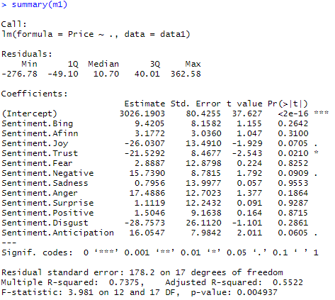
Text Analytics (Unstructured Data)
After the tokenisation process and sentiment analysis, we end up with the above table that shows us the various scores each text article achieved based on each column.
For example, the Sentiment.Bing gives an overall view on how positive or negative a text article is based on the words used in it. It is thought that a negative-sentiment article on a stock would mean that it would do badly and hence have a lower future value / downward pressure on its price.
A quick linear regression on the data showed that at a 10% yardstick, the only statistically significant predictors of the stock price will be Sentiment.Joy, Sentiment.Trust, Sentiment.Negative, and Sentiment.Anticipation. This shows that the most common influencers of the STI price is based on how joyful, trustworthy, negative, or anticipatory emotions that news articles give out.

Slide 41
Other Questions

Slide 42
Sequential VS Non-Sequential Models on Sequential Data
When we use sequential models on non-sequential data:
The whole classification process will still happen regardless, producing outputs from the inputs.
However, there may be underperformance from the sequential models compared to non-sequential models.
Any recurrent value is essentially random, and so the weights assigned to it will go towards zero after several epochs.
When we use non-sequential models on sequential data:
The model will still read in the data and process as usual, but it will not consider the sequential relationship between a row and the next.
I would have expected the accuracy for such non-sequential models to be lower, but they turned out to be higher than the sequential ones. As mentioned, it could be a choice of hyperparameters that did not optimise the models as hoped.

Slide 43
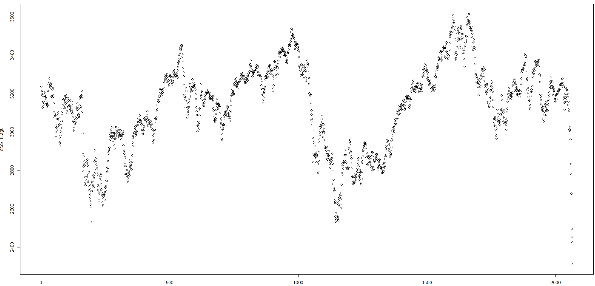
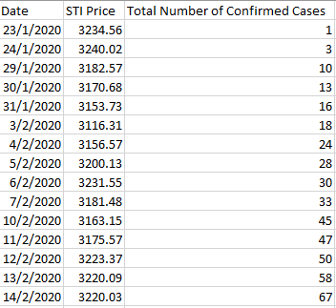
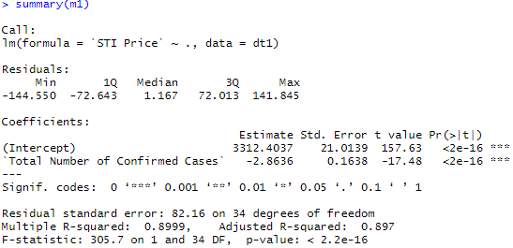
Volatility of STI
The STI is volatile because it is always impacted by world events and investors’ belief in a index.
For example when using linear regression for the STI Price against the Total Number of Confirmed COVID-19 cases, it seems that there is a linear relationship between the two (low p-value and three asterisks).
The coefficient suggests that for every increase in the number of confirmed cases, the STI will fall by SGD 2.86.
Of course in reality, there are many other factors not taken into consideration here, but we just want to show how well

